Slide 1
Modern Asynchronous Programming with JavaScript (Goodbye Callbacks!)
Henrique S. Coelho
Matthew Welke

Slide 2
The Message Queue and Event Loop

Slide 3
Code is a Series of Instructions
Computer reads your code one line at a time.
Before one line can be executed, the line before it must finish executing.
We call this “synchronous” programming.
const x = 42;
const answer = x;
console.log(`The answer to life is ${answer}`);

Slide 4
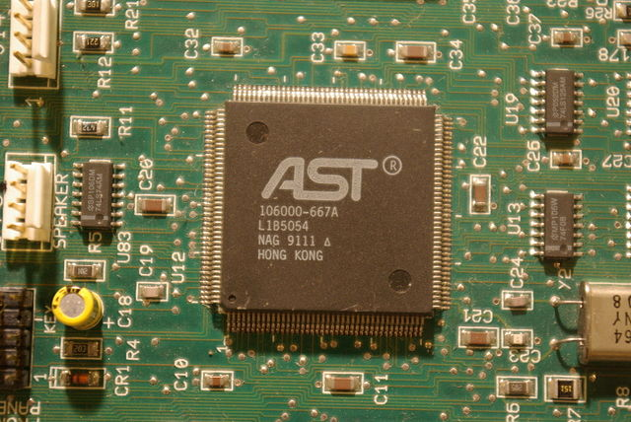
Code is a Series of Instructions Giant While Loop
The CPU runs at a certain frequency.
2.2 GHz = 2,200,000,000 clock cycles per second.
One clock cycle is used to perform a tiny operation.
Those tiny operations add up to doing things like “make a new variable called x and put 42 into it”.
What does this mean?
The Computer could potentially do billions of “things” per second.

Slide 5
Normal Programming
Stack
What is the stack?

Slide 6
Normal Programming
Stack
firstFunction

Slide 7
Normal Programming
Stack

Slide 8
Normal Programming
Stack
someOtherFunction

Slide 9
Normal Programming
Stack

Slide 10
Normal Programming
Stack
function firstFunction() {
secondFunction();
}
firstFunction

Slide 11
Normal Programming
Stack
function firstFunction() {
secondFunction();
}
secondFunction
firstFunction

Slide 12
Normal Programming
Stack
thirdFunction
secondFunction
firstFunction

Slide 13
Normal Programming
Stack
secondFunction
firstFunction

Slide 14
Normal Programming
Stack
firstFunction

Slide 15
Normal Programming
Stack

Slide 16
Normal Programming
Stack
Heap
function cleanKitchen() {
console.log(‘Cleaned kitchen.’);
}
function cleanHome() {
cleanKitchen();
console.log(‘Cleaned home.’);
}
cleanHome();

Slide 17
Normal Programming
Stack
Heap
function cleanKitchen() {
console.log(‘Cleaned kitchen.’);
}
function cleanHome() {
cleanKitchen();
console.log(‘Cleaned home.’);
}
cleanHome();
cleanHome

Slide 18
Normal Programming
Stack
Heap
function cleanKitchen() {
console.log(‘Cleaned kitchen.’);
}
function cleanHome() {
cleanKitchen();
console.log(‘Cleaned home.’);
}
cleanHome();
cleanKitchen
cleanHome

Slide 19
Normal Programming
Stack
Heap
function cleanKitchen() {
console.log(‘Cleaned kitchen.’);
}
function cleanHome() {
cleanKitchen();
console.log(‘Cleaned home.’);
}
cleanHome();
console.log
cleanKitchen
cleanHome

Slide 20
Normal Programming
Stack
Heap
function cleanKitchen() {
console.log(‘Cleaned kitchen.’);
}
function cleanHome() {
cleanKitchen();
console.log(‘Cleaned home.’);
}
cleanHome();
console.log
cleanHome

Slide 21
Normal Programming
Stack
Heap
function cleanKitchen() {
console.log(‘Cleaned kitchen.’);
}
function cleanHome() {
cleanKitchen();
console.log(‘Cleaned home.’);
}
cleanHome();
cleanHome

Slide 22
Normal Programming
Stack
Heap
function cleanKitchen() {
console.log(‘Cleaned kitchen.’);
}
function cleanHome() {
cleanKitchen();
console.log(‘Cleaned home.’);
}
cleanHome();

Slide 23
Asynchronous JavaScript Programming
Stack
Heap
function cleanKitchen() {
console.log(‘Started dishwasher.’);
setTimeout(function cb() {
console.log(‘Dishwasher done. Cleaned kitchen.’);
console.log(‘Cleaned home.’);
}, 30000); // Add msg to queue in 30s
}
function cleanHome() {
cleanKitchen();
}
cleanHome();
Queue

Slide 24
Asynchronous JavaScript Programming
Stack
Heap
function cleanKitchen() {
console.log(‘Started dishwasher.’);
setTimeout(function cb() {
console.log(‘Dishwasher done. Cleaned kitchen.’);
console.log(‘Cleaned home.’);
}, 30000); // Add msg to queue in 30s
}
function cleanHome() {
cleanKitchen();
}
cleanHome();
Queue

Slide 25
Asynchronous JavaScript Programming
Stack
Heap
function cleanKitchen() {
console.log(‘Started dishwasher.’);
setTimeout(function cb() {
console.log(‘Dishwasher done. Cleaned kitchen.’);
console.log(‘Cleaned home.’);
}, 30000); // Add msg to queue in 30s
}
function cleanHome() {
cleanKitchen();
}
cleanHome();
Queue

Slide 26
Asynchronous JavaScript Programming
Stack
Heap
function cleanKitchen() {
console.log(‘Started dishwasher.’);
setTimeout(function cb() {
console.log(‘Dishwasher done. Cleaned kitchen.’);
console.log(‘Cleaned home.’);
}, 30000); // Add msg to queue in 30s
}
function cleanHome() {
cleanKitchen();
}
cleanHome();
cleanHome
Queue

Slide 27
Asynchronous JavaScript Programming
Stack
Heap
function cleanKitchen() {
console.log(‘Started dishwasher.’);
setTimeout(function cb() {
console.log(‘Dishwasher done. Cleaned kitchen.’);
console.log(‘Cleaned home.’);
}, 30000); // Add msg to queue in 30s
}
function cleanHome() {
cleanKitchen();
}
cleanHome();
cleanKitchen
cleanHome
Queue

Slide 28
Asynchronous JavaScript Programming
Stack
Heap
function cleanKitchen() {
console.log(‘Started dishwasher.’);
setTimeout(function cb() {
console.log(‘Dishwasher done. Cleaned kitchen.’);
console.log(‘Cleaned home.’);
}, 30000); // Add msg to queue in 30s
}
function cleanHome() {
cleanKitchen();
}
cleanHome();
console.log
cleanKitchen
cleanHome
Queue

Slide 29

Asynchronous JavaScript Programming
Stack
Heap
function cleanKitchen() {
console.log(‘Started dishwasher.’);
setTimeout(function cb() {
console.log(‘Dishwasher done. Cleaned kitchen.’);
console.log(‘Cleaned home.’);
}, 30000); // Add msg to queue in 30s
}
function cleanHome() {
cleanKitchen();
}
cleanHome();
webapi
setTimeout
cb
cleanKitchen
You wouldn’t just stand by the dishwasher and wait for it to finish.
You’d start it and work on something else.
cleanHome
Queue

Slide 30
Asynchronous JavaScript Programming
Stack
Heap
function cleanKitchen() {
console.log(‘Started dishwasher.’);
setTimeout(function cb() {
console.log(‘Dishwasher done. Cleaned kitchen.’);
console.log(‘Cleaned home.’);
}, 30000); // Add msg to queue in 30s
}
function cleanHome() {
cleanKitchen();
}
cleanHome();
webapi
cb
cleanHome
Queue

Slide 31
Asynchronous JavaScript Programming
Stack
Heap
function cleanKitchen() {
console.log(‘Started dishwasher.’);
setTimeout(function cb() {
console.log(‘Dishwasher done. Cleaned kitchen.’);
console.log(‘Cleaned home.’);
}, 30000); // Add msg to queue in 30s
}
function cleanHome() {
cleanKitchen();
}
cleanHome();
webapi
cb
Queue

Slide 32
Asynchronous JavaScript Programming
Stack
Heap
function cleanKitchen() {
console.log(‘Started dishwasher.’);
setTimeout(function cb() {
console.log(‘Dishwasher done. Cleaned kitchen.’);
console.log(‘Cleaned home.’);
}, 30000); // Add msg to queue in 30s
}
function cleanHome() {
cleanKitchen();
}
cleanHome();
webapi
Queue
cb

Slide 33
Asynchronous JavaScript Programming
Stack
Heap
function cleanKitchen() {
console.log(‘Started dishwasher.’);
setTimeout(function cb() {
console.log(‘Dishwasher done. Cleaned kitchen.’);
console.log(‘Cleaned home.’);
}, 30000); // Add msg to queue in 30s
}
function cleanHome() {
cleanKitchen();
}
cleanHome();
cb
Queue

Slide 34
Asynchronous JavaScript Programming
Stack
Heap
function cleanKitchen() {
console.log(‘Started dishwasher.’);
setTimeout(function cb() {
console.log(‘Dishwasher done. Cleaned kitchen.’);
console.log(‘Cleaned home.’);
}, 30000); // Add msg to queue in 30s
}
function cleanHome() {
cleanKitchen();
}
cleanHome();
console.log
cb
Queue

Slide 35
Asynchronous JavaScript Programming
Stack
Heap
function cleanKitchen() {
console.log(‘Started dishwasher.’);
setTimeout(function cb() {
console.log(‘Dishwasher done. Cleaned kitchen.’);
console.log(‘Cleaned home.’);
}, 30000); // Add msg to queue in 30s
}
function cleanHome() {
cleanKitchen();
}
cleanHome();
console.log
cb
Queue

Slide 36
Asynchronous JavaScript Programming
Stack
Heap
function cleanKitchen() {
console.log(‘Started dishwasher.’);
setTimeout(function cb() {
console.log(‘Dishwasher done. Cleaned kitchen.’);
console.log(‘Cleaned home.’);
}, 30000); // Add msg to queue in 30s
}
function cleanHome() {
cleanKitchen();
}
cleanHome();
Queue

Slide 37
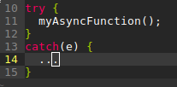
Some things have to be done in synchrony
No try/catch
> getInformationFromDatabase();
> buildHTMLTemplate();
> sendResponse();
Does not work!
example 1.js

Slide 38
Methods of Asynchronous programming
Callbacks
Promises (ES6)
Generators (ES6)
Async functions (ES7)

Slide 39
Callbacks
A chain of instructions. Pass what to do next when the function is done
Without callbacks
Callbacks
Function 1
Function 1
Function 2
Function 2
Function 3
Function 3
example callback1.js, callback2.js, callback3.js

Slide 40
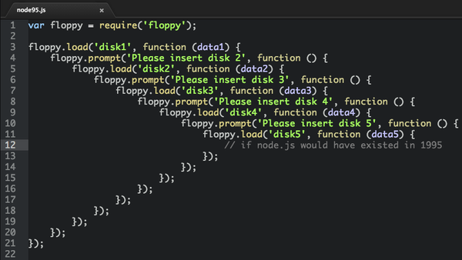
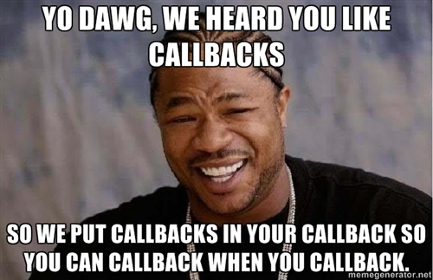
Callback hell
example callback1.js

Slide 41
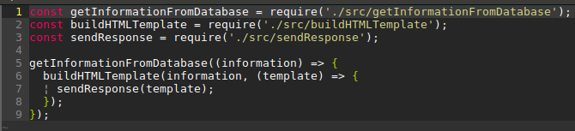

Promises
Callbacks
Promises
example promise1.js, promise2.js

Slide 42
Promises
Other useful methods:
Promise.all([ Promises ]) - Succeeds as soon as one of the promises finish
Promise.race([ Promises ]) - Succeeds when all the promises succeed
example promise3.js

Slide 43


Generators
In simple terms, it is a factory for iterators
Iterators are collections that allow you to access its content one item at a time, normally with a .next() method
example generator1.js

Slide 44
Async Functions
New in ES7
Functions that return promises (have the method .then())
Provide the keyword await - it waits for promises to be completed (somehow similar to yield)
example async1.js, async2.js

Slide 45
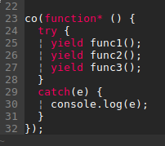
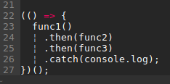
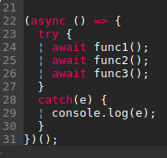
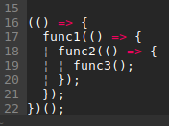
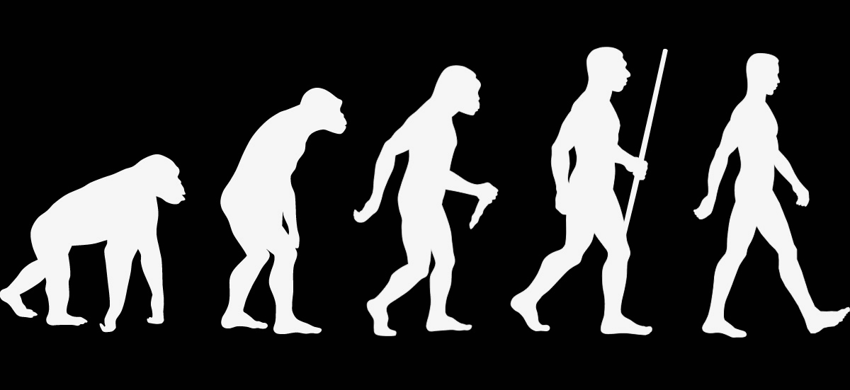
Conclusion

